Slide 1
Machine learning model for Fundus image
By
Ravi kandulna
V. Sivakumar

Slide 2
Contents
Fundus Image
Types of libraries
Algorithm
Dataset
Software
output.

Slide 3
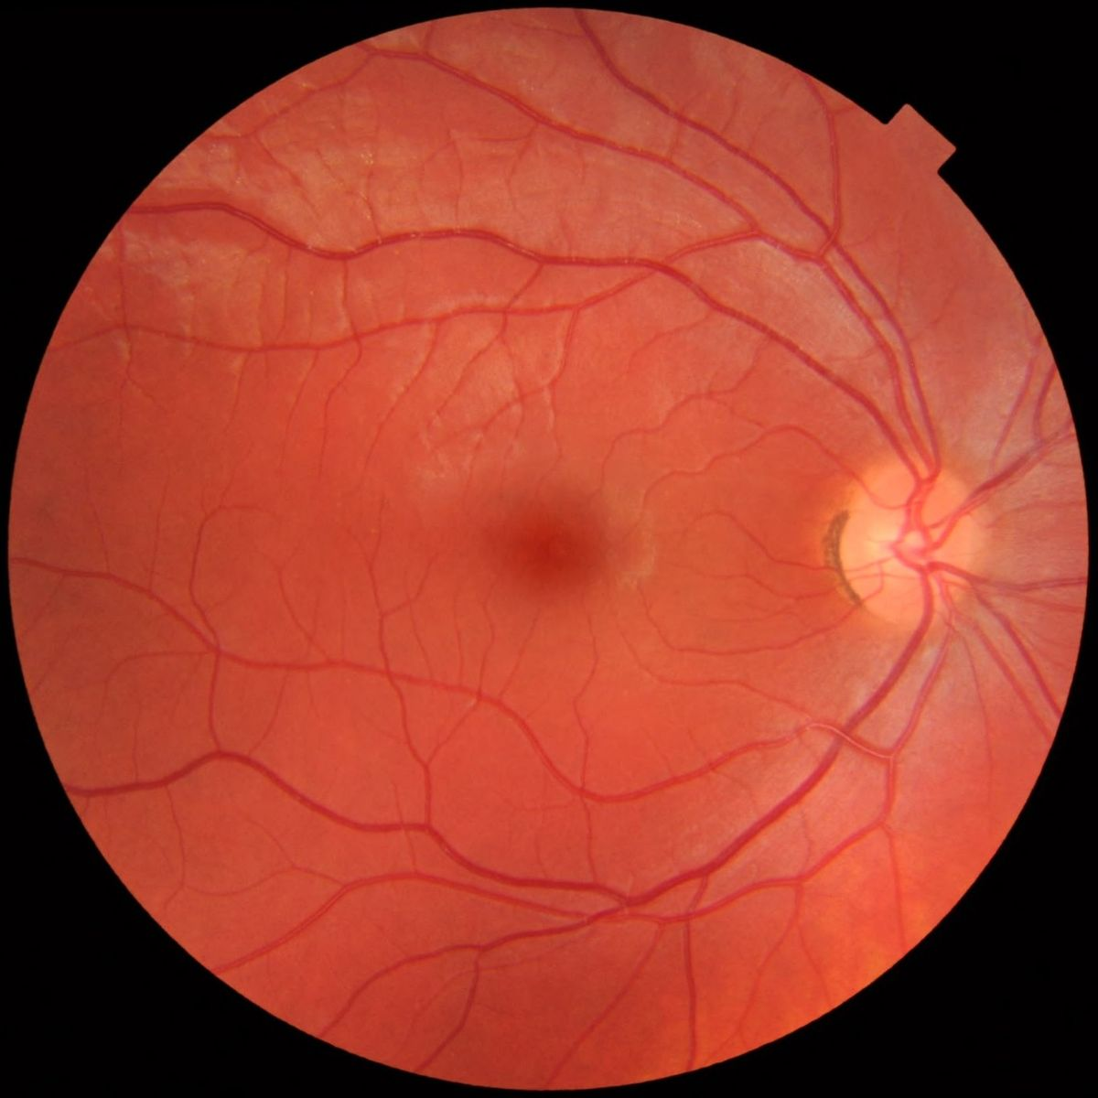
FUNDUS IMAGE
Fundus photography is taking the image of the retina of the eye with a fundus camera.
So the diseased people have different
types of fundus image so we can use those
images to predict to the type of disease a particular person is having

Slide 4
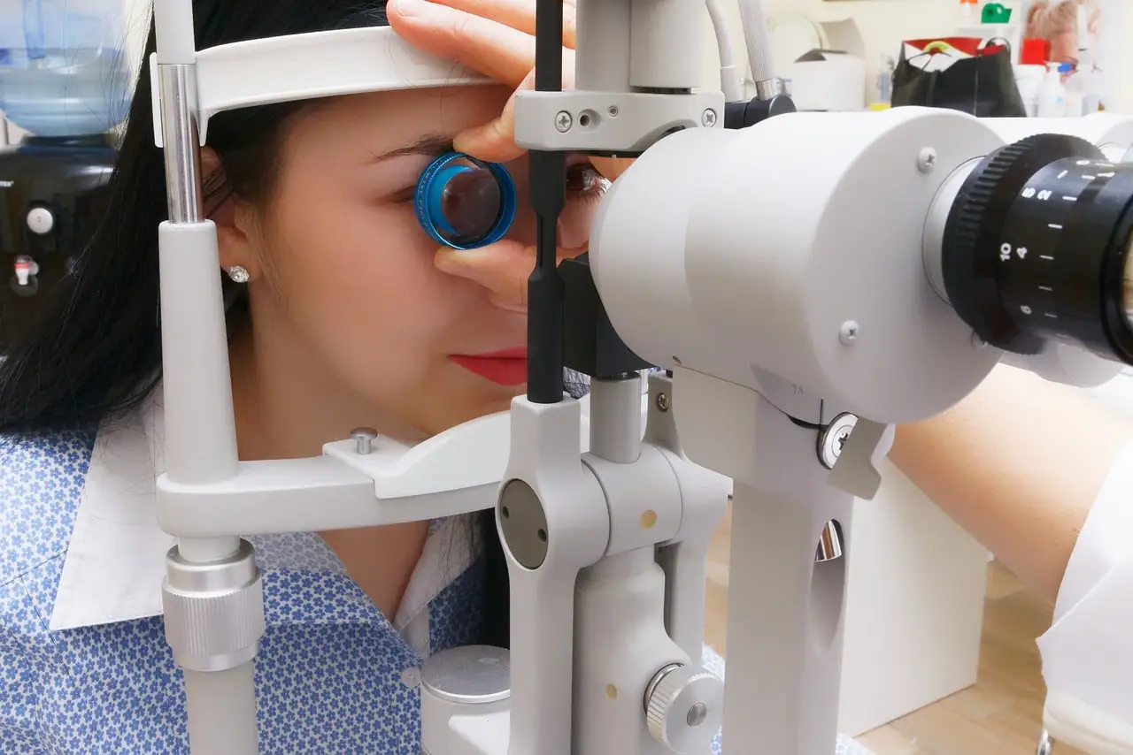
How fundus image are taken
Specialized fundus cameras consisting of an intricate microscope attached to a flash enabled camera are used in fundus photography.

Slide 5
Process
Upload the image
Predicts the image using the background api
Print the output

Slide 6
Libraries
Tensor flow
Keras
Pillow
Streamlit
Numpy

Slide 7
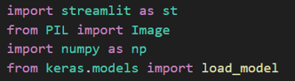
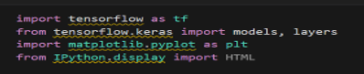
Libraries

Slide 8
Algorithm
CNN - Convolutional neural network
A convolutional neural network (CNN or ConvNet) is a network architecture for deep learning that learns directly from data. CNNs are particularly useful for finding patterns in images to recognize objects, classes, and categories. They can also be quite effective for classifying audio, time-series, and signal data.

Slide 9
Dataset
The dataset is collected from Kaggle which has four types of disease classification images.
Glaucoma
Cataract
Diabetics retinopathy
Normal

Slide 10
Software
The software used here are
Pycharm
Jupyter notebook

Slide 11
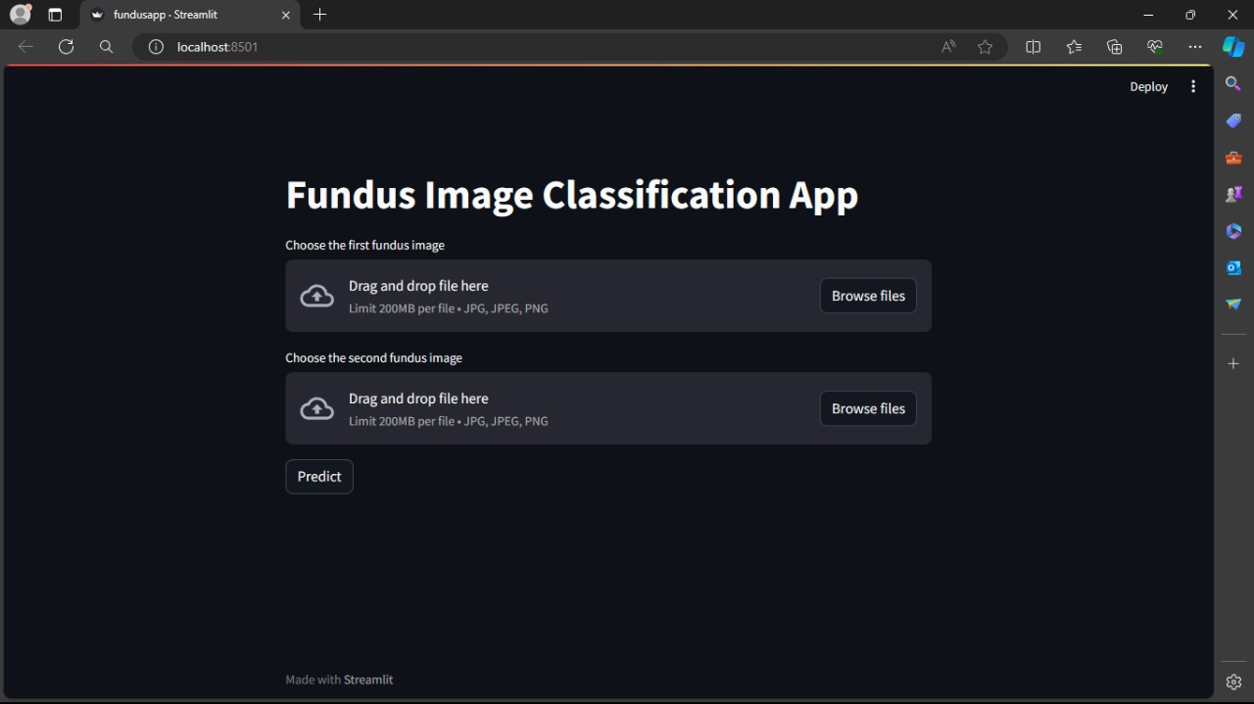
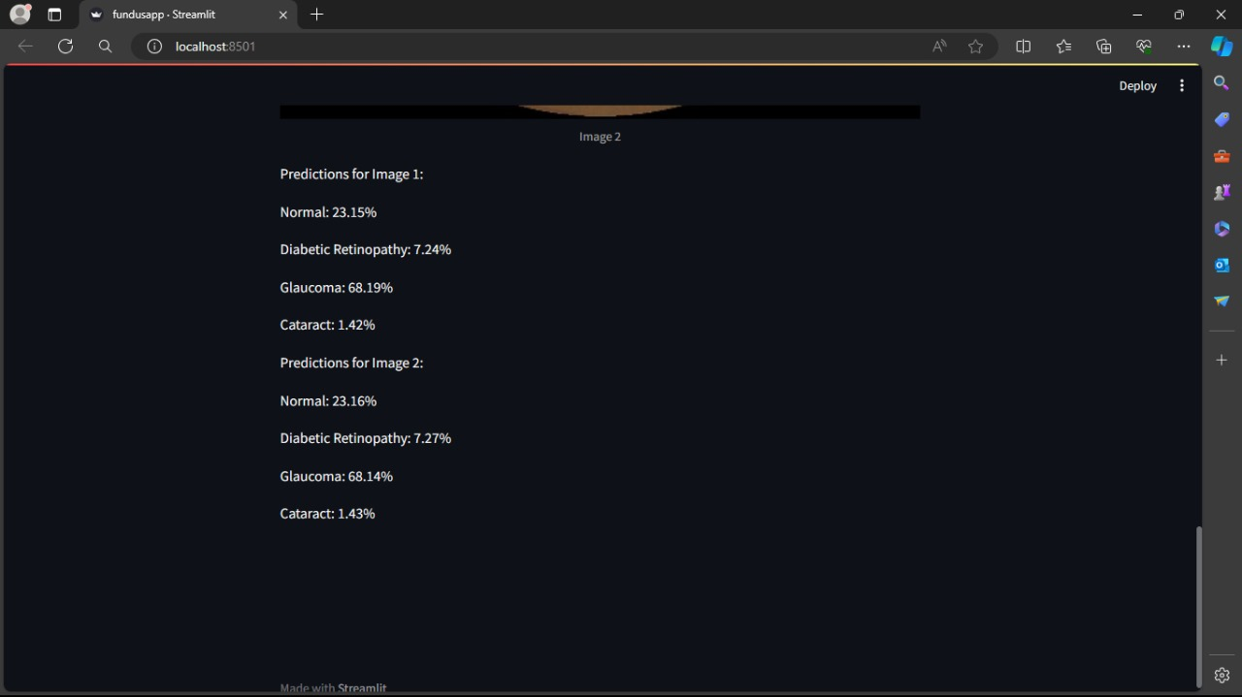
Output

Slide 12
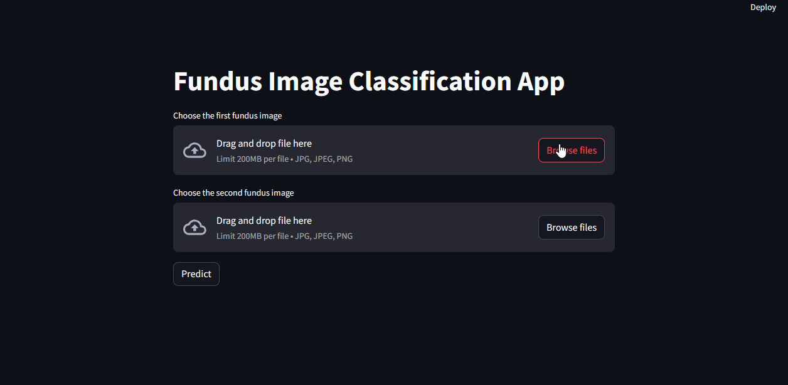
Output

Slide 13
Thank you

